Slide 1

Chester Business Networking 2026
Notes:
Chris simpson – intro to reviving things

Slide 2



















19 Businesses locally…
Notes:
We’ve tried to all the business – there’s a wide span of businesses, but there is one common thing across all of the businesses and that is the need to grow them – if we can unlock the blockers to growth and ramp them up, it will be prosperity to the place

Slide 3
Dylan - Context for the basis:
9th October 2024 – DAH to Darryl Newton:
Use an external chair to get ideas – get them to pump the businesses up
Sharing numbers – it is difficult if you don’t.
Meeting could run like this: I’m looking to grow my business, these are my numbers, this is my team, this is what we do, how can we grow and what do we need to do?
Getting the place more sustainable
Father goes by open and honest communication removes the anxiety of the unknown.
Need for networking together and use resource amongst the brethren.
Meetings could run every quarter or every 6 months
Attending – all business owners there, and managers if owners happy.
Employment – working together and so businesses can be strengthened.
Only number spoke about EBITDA. How can increase that?
Notes:
We wanted to pick up the input the place has had when we got some nuggets when Darryl got the privilege of speaking with Mr Dean Hales

Slide 4
Ross - Our Shared Vision for Chester for next 3 years
“ An administration for the benefit of all“
Notes:
Ross -

Slide 5
Dylan - 2026 SCHEDULE – the 2nd Friday of the month
DATES | TYPE | FACILITATOR AND EXTERNAL CHAIRMAN | KEY TOPICS
JANUARY 9th | TEAMS LAUNCH | CHRIS SIMPSON | LAUNCH AND SET OUT 2026 SHEDULE
FEBRUARY 13th | QUARTERLY F2F 7AM – 11:00AM
MARCH 13th | TEAMS 7am – 07:30
APRIL 10th | TEAMS 7am – 07:30
MAY 8th | QUARTERLY F2F 7AM – 11:00AM
JUNE 12th | TEAMS 7am – 07:30
JULY 10th | TEAMS 7am – 07:30
AUGUST 14th | QUARTERLY F2F 7AM – 11:00AM
SEPTEMBER 11th | TEAMS 7am – 07:30
OCTOBER 9th | TEAMS 7am – 07:30
NOVEMBER 13th | QUARTERLY F2F 7AM – 11:00AM
DECEMBER 11th | TEAMS 7am – 07:30
DECEMBER 11th | TEAMS 7am – 07:30
Notes:
Dylan – had a look at how we can make it more value-add and try and execute the input from what Darryl got.
if we could do a more focussed quarterly face to face meeting offsite at a decent venue like doubletree hotel and put some effort into getting input from the businesses of the key challenges – we could brainstorm the fixes and help hold the businesses to account to implement things
Then in between quarterly ones we’d have a quick 30 minute catch up on teams to go through the key metrics
Try and get a different person involved to facilitate each time – some suggestions below

Slide 6
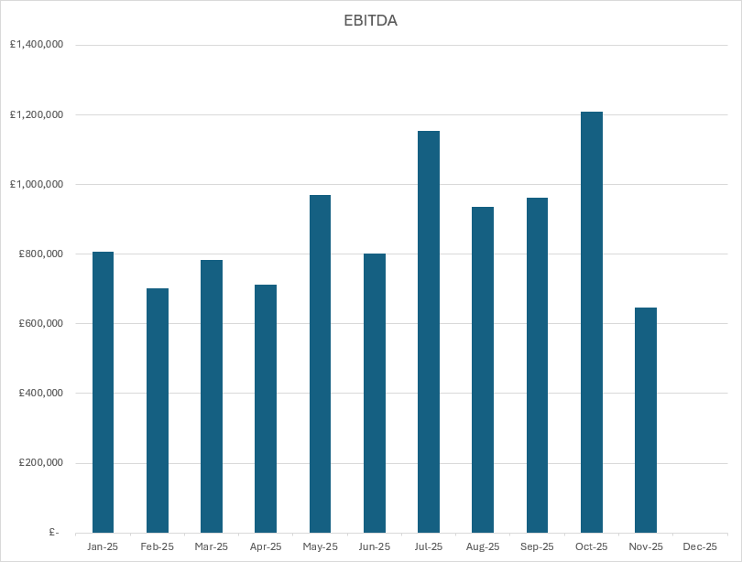
AGGREGATE EBITDA (SHANE)
Notes:
Shane to talk through this – standardised reporting so we know if we’re going forward or backwards

Slide 7
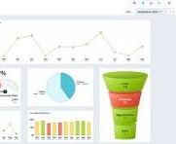
Can we measure a common KPI across all the businesses?
Notes:
Rory – we thought if we could find maybe a KPI or a couple which are common across all the businesses, then we could share these targets and hold ourselves accountable to ramp it up

Slide 8
1 Key Win and 1 blocker to growth per business – 10 mins (complete slides first)
Business Name
Key Win
Key Blocker to growth
Brainstorm ideas as a team
Capture clear executable actions
Notes:
Dylan – so the idea is that on the face to face sessions, each business would get input to remove blockers to growth and ramp things up.
We may need to work out the best way to do this – whether to do either:
Maybe half the businesses each time
Split the businesses into groups based on the types of challenges they want input on – eg sales or marketing or finance
May need to play it by ear and see what gives the best value

Slide 9

Getting some feedback for first F2F
Scan the QR to fill in the form and input what the No1 blocker that you would want input on
Select what the main KPI’s you track are
VELOCITY 26 - CHESTER - Launch Feedback Form – Fill out form
Notes:
Shane/Dylan – collating the data for the first session in person

Slide 10
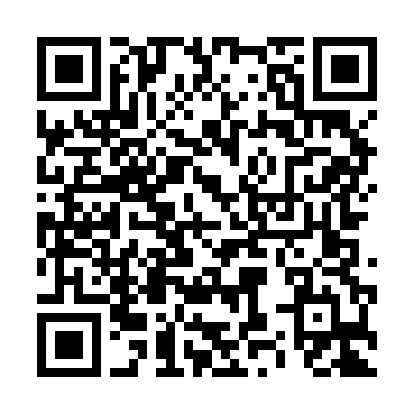
WRAP UP
Confirm Actions – what by when by who
Score the meeting out of 10
Please fill in the survey that will be sent around after to give feedback
https://app.smartsheet.com/b/form/f215c95d1a4f4d45a4e03ea2aba82943
Notes:
Dylan – after each session, we’ll score the meeting and get feedback to improve

